Slide 1
Vehicle Detection and Tracking
Arvind C S

Slide 2
Overview
Detection and tracking of multiple vehicles using a mounted camera inside a self-driving car.
Detector localizes the vehicles in each frame.
The tracker is then updated with the detection results
We use a lightweight model: ssd_mobilenet_v1_coco that is based on Single Shot Multibox Detection (SSD) framework with minimal modification

Slide 3
Vehicle Detection and Tracking Overview
Frame with Vehicle
Vehicle Detection using SSD
Tracking Detected Vehicle using Kalman filter

Slide 4
Detection
In this work, vehicle (car) detection takes a captured image as input and produces the bounding boxes as the output.
We use TensorFlow Object Detection API, which is an open source framework built on top of TensorFlow to construct, train and deploy object detection models.
The Object Detection API also comes with a collection of detection models pre-trained on the COCO dataset that are well suited for fast prototyping.
Specifically, we use a lightweight model: ssd_mobilenet_v1_coco that is based on Single Shot Multibox Detection (SSD) framework with minimal modification.
Though this is a general-purpose detection model (not specifically optimized for car detection), we find this model meets our objective of achieving the balance between good bounding box accuracy and reasonable running time.

Slide 5
Dataset COCO
The COCO dataset contains images of 90 classes, with the first 14 classes all related to transportation, including bicycle, car, and bus, etc. The ID for car is 3.
category_index =
{1: {'id': 1, 'name': u'person'},
2: {'id': 2, 'name': u'bicycle'},
3: {'id': 3, 'name': u'car'},
4: {'id': 4, 'name': u'motorcycle'},
5: {'id': 5, 'name': u'airplane'},
6: {'id': 6, 'name': u'bus'},
7: {'id': 7, 'name': u'train'},
8: {'id': 8, 'name': u'truck'},
9: {'id': 9, 'name': u'boat'},
10: {'id': 10, 'name': u'traffic light'},
11: {'id': 11, 'name': u'fire hydrant'},
13: {'id': 13, 'name': u'stop sign'},
14: {'id': 14, 'name': u'parking meter'}}

Slide 6
Kalman Filter for Bounding Box Measurement
Kalman filter for tracking objects. Kalman filter has the following important features that tracking can benefit from:
Prediction of object's future location
Correction of the prediction based on new measurements
Reduction of noise introduced by inaccurate detections
Facilitating the process of association of multiple objects to their tracks
Kalman filter consists of two steps: prediction and update. The first step uses previous states to predict the current state. The second step uses the current measurement, such as detection bounding box location , to correct the state.

Slide 7
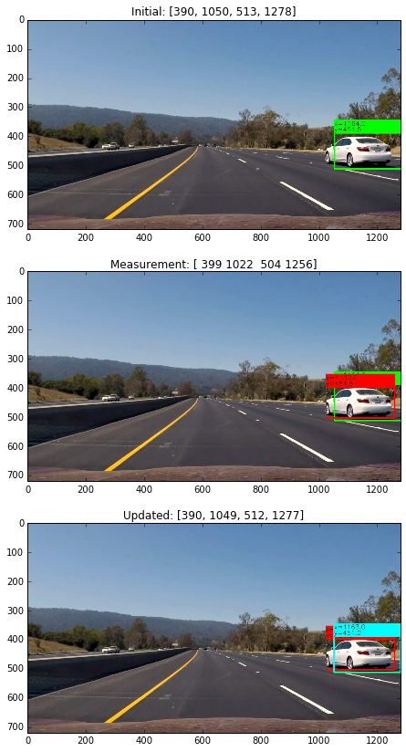
Kalman Filter Tracking OUTPUT

Slide 8
Multiple Vehicle Detection and Tracking
If there are multiple detections, we need to match (assign) each of them to a tracker. We use intersection over union (IOU) of a tracker bounding box and detection bounding box as a metric.
We solve the maximizing the sum of IOU assignment problem using the Hungarian algorithm

Slide 9
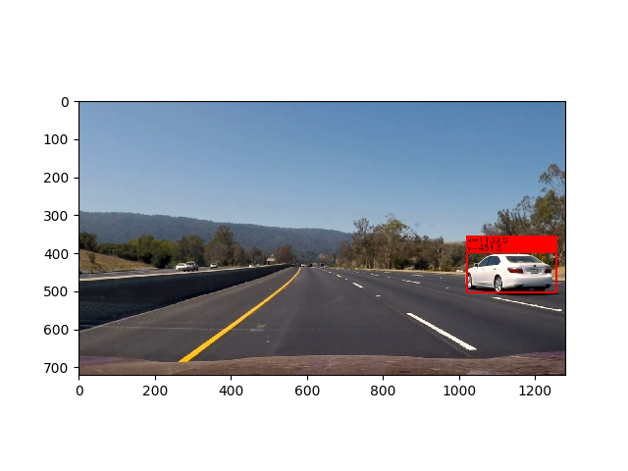
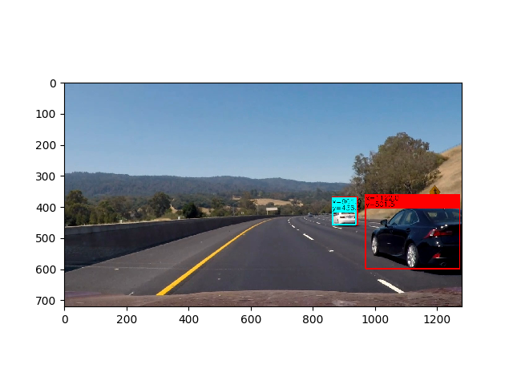
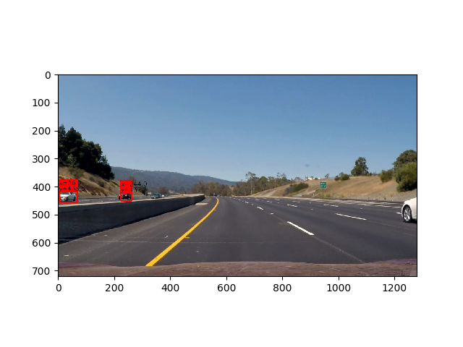
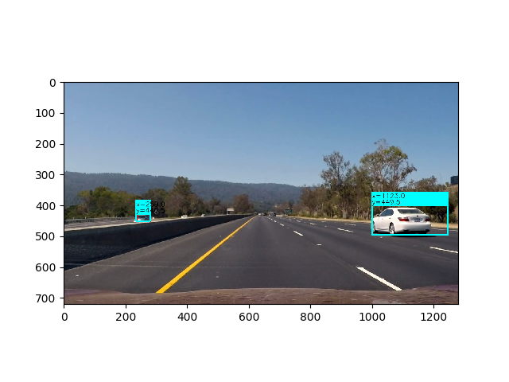
Vehicle Detection Results
Red Box Vehicle Detection
Red Box Vehicle Detection
Blue is tracking Vehicle by kalam filter
Red Box Vehicle Detection
Red Box Vehicle Detection
Blue is tracking Vehicle by kalam filter

